Slide 1
National Child Measurement Programme (NCMP) 2021-22
The Joint Strategic Needs Assessment (JSNA) provides information on the current and future health and wellbeing needs of people in Bradford District visit https://jsna.bradford.gov.uk
Public Health Intelligence Team
Department of Health & Wellbeing, Public Health

Slide 2
Introduction and the impact of the COVID-19 pandemic
The National Child Measurement Programme (NCMP), established in 2006, collects annual measurements of the height and weight of over one million children in Reception (age 4-5 years) and Year 6 (age 10-11 years) in primary schools across England.
The 2019 to 2020 NCMP data collection stopped in March 2020 when schools were closed due to the COVID-19 pandemic. 2021 to 2022 NCMP was the first data collection since the coronavirus COVID-19 pandemic that was unaffected by school closures and other public health measures.
Therefore, 2021-22 data is compared to 2019-20 data where appropriate. There maybe instances where due to the smaller numbers measured in 2019-20 that comparisons in specific areas cannot be made, in particular deprivation.
The participation rate in Bradford in 2021 to 2022 was 90.3% in Reception children and 88.5% for children in Year 6.

Slide 3
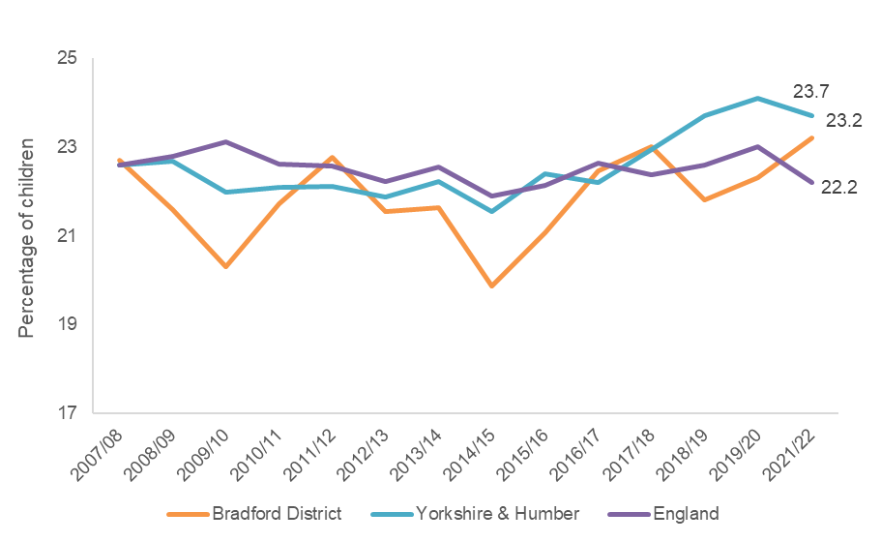
Excess Weight - Reception Prevalence of reception aged children who are overweight (including obesity)
The prevalence of reception aged children who are overweight (including obesity) in the Bradford district has increased to 23.2% compared to 22.3% in 2019-20.
The prevalence of reception aged children who are overweight (including obesity) in the Bradford district is above the England average of 22.2%.
.
Bradford has the 60th highest prevalence of reception aged children who are overweight (including obesity) out of the 150 local authorities in England

Slide 4
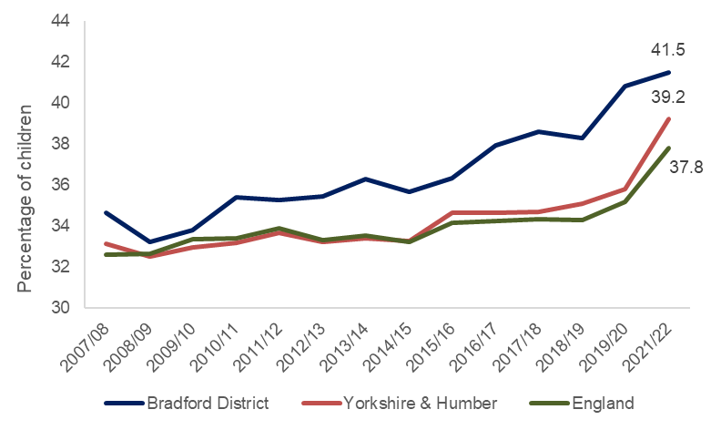
Excess Weight – Year 6 Prevalence of Year 6 children who are overweight (including obesity)
** The prevalence of year 6 children who are overweight (including obesity) in the Bradford district has increased to 41.5% compared to 40.8% in 2019-20.
The prevalence of year 6 children who are overweight (including obesity) in the Bradford district remains above national average; 37.8%.
**interpret with caution - due to smaller number of children measured
Bradford has the 42nd highest year 6 children who are overweight (including obesity) out of the 150 local authorities in England

Slide 5
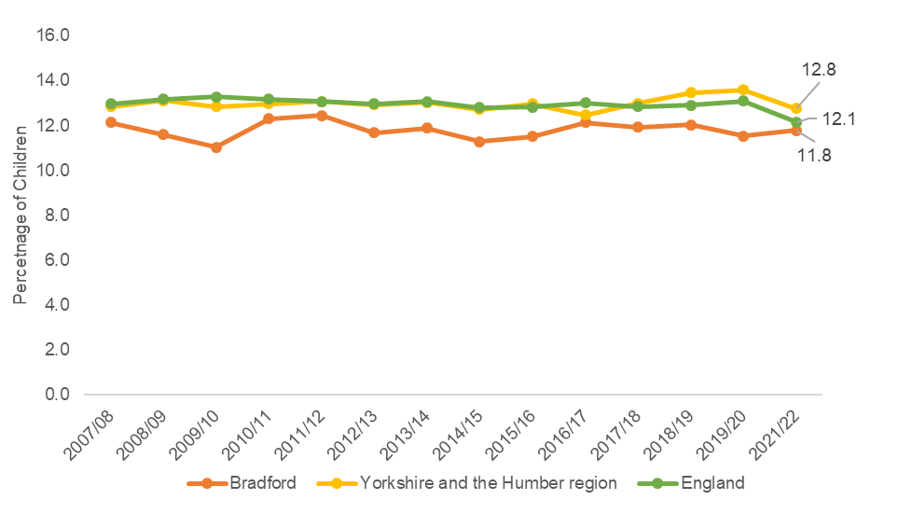
Overweight - Reception Prevalence of reception aged children who are overweight
The prevalence of reception aged children who are overweight in the Bradford district has increased to 11.8% compared to 11.5% in 2019-20.
The prevalence of reception aged children who are overweight in the Bradford district is below the England average of 12.1%.
.
Bradford has the 57th lowest prevalence of reception aged children who are overweight out of the 150 local authorities in England

Slide 6
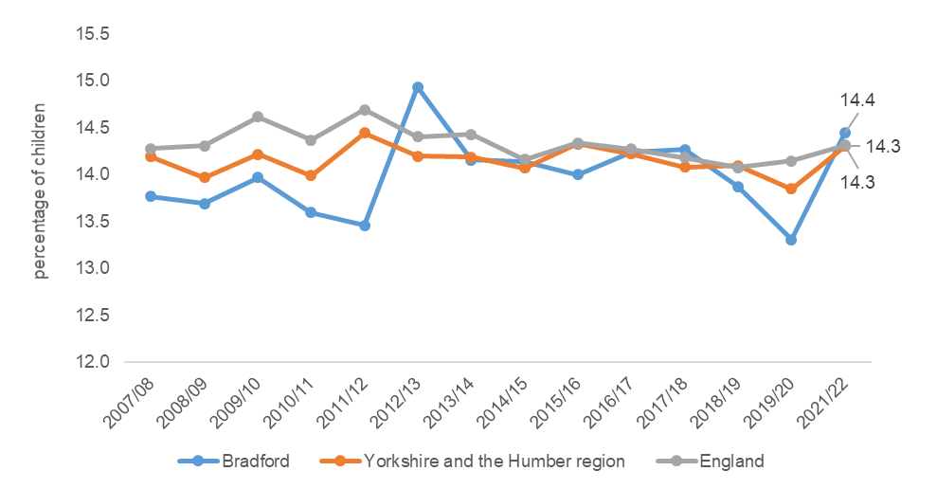
Overweight – Year 6 Prevalence of Year 6 aged children who are overweight
** The prevalence of Year 6 children who are overweight in the Bradford district has increased to 14.4% compared to 13.3% in 2019-20.
The prevalence of Year 6 aged children who are overweight in the Bradford district is above the England average of 14.3%.
.
**interpret with caution - due to smaller number of children measured
Bradford has the 70th highest prevalence of reception aged children who are overweight out of the 150 local authorities in England

Slide 7
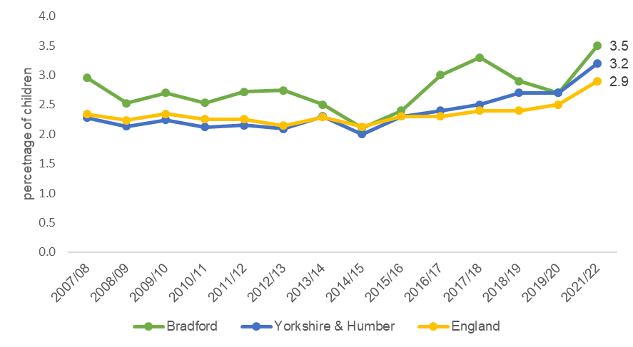
Severe Obesity - Reception Reception - Prevalence of severe obesity
The prevalence of severe obesity in reception aged children in the Bradford district has increased to 3.5% compared to 2.7% in 2019-20.
The prevalence of severe obesity reception aged children in the Bradford district is above the England average of 2.9%.
Bradford has the 41st highest reception aged children who are severely obese out of the 150 local authorities in England

Slide 8
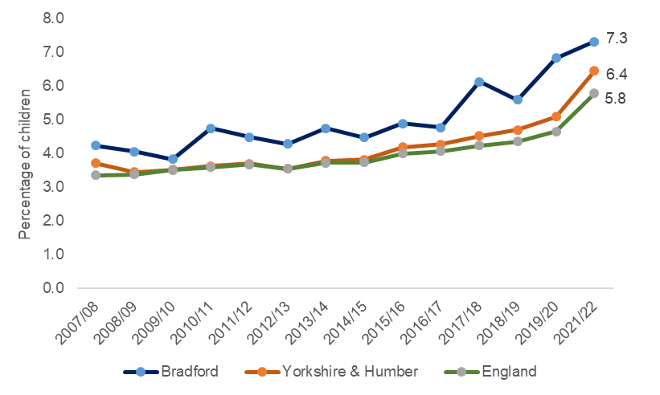
Severe Obesity – Year 6 Year 6 - Prevalence of severe obesity
**The prevalence of severe obesity in year 6 children in the Bradford district has increased to 7.3% compared to 6.8% in 2019-20.
The prevalence of severe obesity in year 6 children in the Bradford district remains above national average; 5.8%.
**interpret with caution - due to smaller number of children measured
Bradford has the 40th highest Year 6 children who are severely obese out of the 150 local authorities in England

Slide 9
Excess Weight – Reception BMI status of reception children
In 2021-22 Nearly three quarters of reception children had a BMI status in healthy weight range which has decreased compared to 2019-20 (76.2%)
1.8% reception children had a BMI status as underweight, an increase compared to 2019-20 (1.4%)

Slide 10
Excess Weight – Year 6 BMI status of Year 6 children
In 2021-22 56.2% of Year 6 children had a BMI status in healthy weight range in 2021-22 which has increased compared to 2019-20 (55.9%)
2.2% of Year 6 children had a BMI status as underweight, an decrease compared to 2019-20 (2.9%)

Slide 11
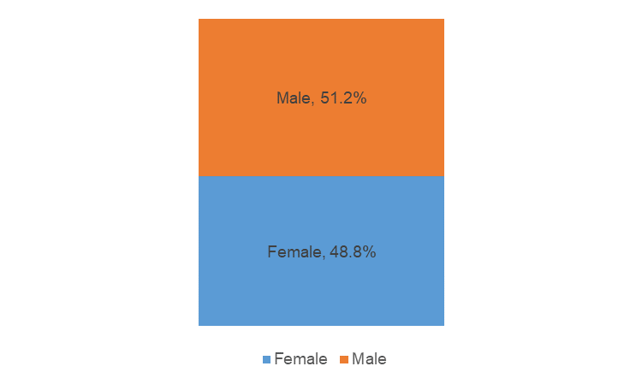
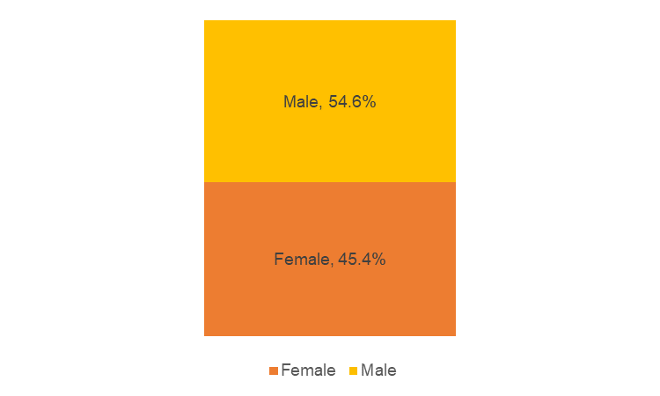
Excess Weight Gender - children who are overweight or very overweight
Reception
Year 6
There is a higher proportion of males compared to females in Reception that are either overweight or very overweight.
There is a higher proportion of males compared to females in Year 6 that are overweight or very overweight.

Slide 12
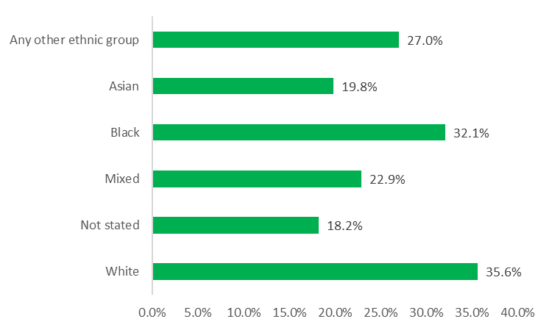
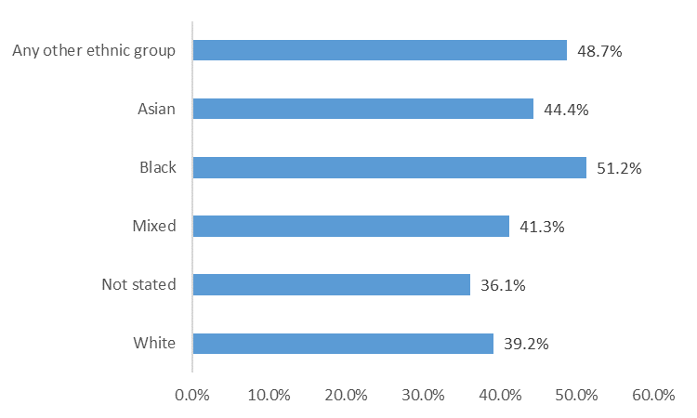
Excess Weight Ethnicity
Reception
Year 6
The prevalence of excess weight in reception varies between different ethnic groups across the district from 19.8% to 35.6% (not including “not stated”)
** The prevalence of excess weight in Year 6 varies between different ethnic groups across the district from 39.2% to 51.2% (not including “not stated”)
**due to smaller number of children measured in some ethnic groups, interpret with caution

Slide 13
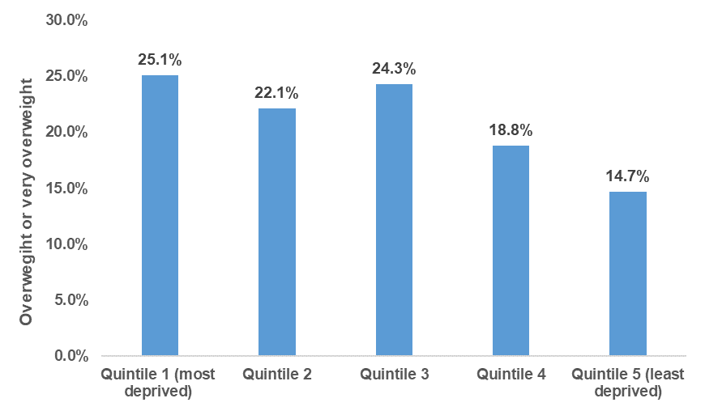
Excess Weight – Reception Deprivation
10.4 percentage points
Most deprived quintile
Least deprived quintile
The proportion of Reception children that are classified overweight or very overweight within each quintile ranges from 14.7% to 25.1%.
In 2021/22 the gap between the most and least deprived quintiles within the district was 10.4 percentage points
Deprivation Gap
Due to smaller numbers measured in 2019-20 comparisons are not made

Slide 14
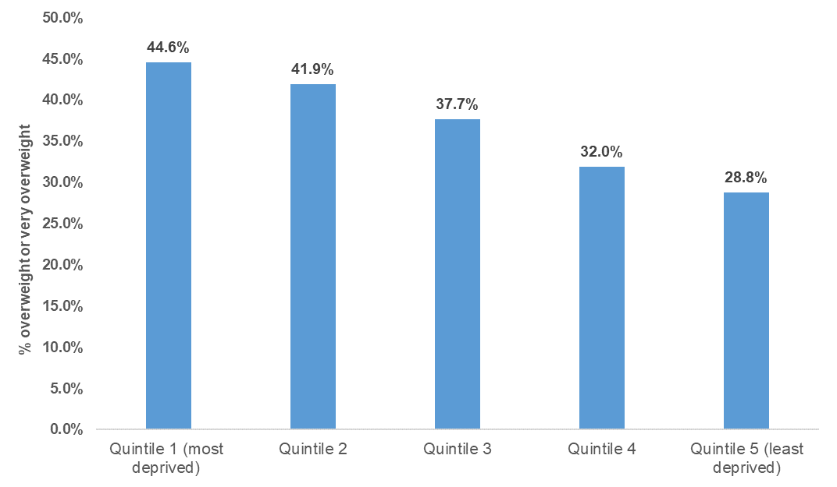
Excess Weight – Year 6 Deprivation
15.8 percentage points
Most deprived quintile
Least deprived quintile
Deprivation Gap
The proportion of Year 6 children that are classified overweight or very overweight increases as deprivation increases
In 2021/22 the gap between the most and least deprived quintiles within the district was 15.8 percentage points
Due to smaller numbers measured in 2019-20 comparisons are not made

Slide 15
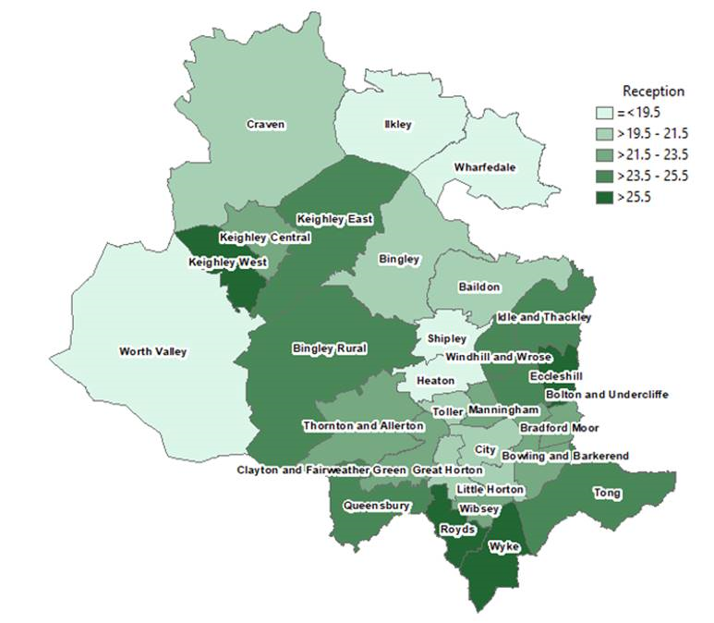
Ward distribution: 3 year data combined – Reception
Prevalence of excess weight across the wards of Bradford District ranges from 17.6% to 26.9%
Ilkley has the lowest proportion of 4-5 year olds with excess weight
Eccleshill has the highest proportion of 4-5 year olds with excess weight

Slide 16
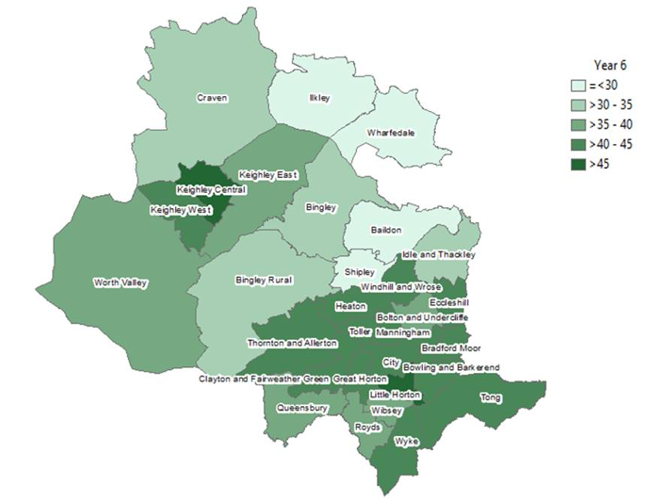
Ward distribution: 3 year data combined – Year 6
Prevalence of excess weight across the wards of Bradford District ranges from 19.7% to 45.2%.
Ilkley has the lowest proportion of Year 6 children with excess weight
Keighley Central has the highest proportion of Year 6 children with excess weight

