Slide 1
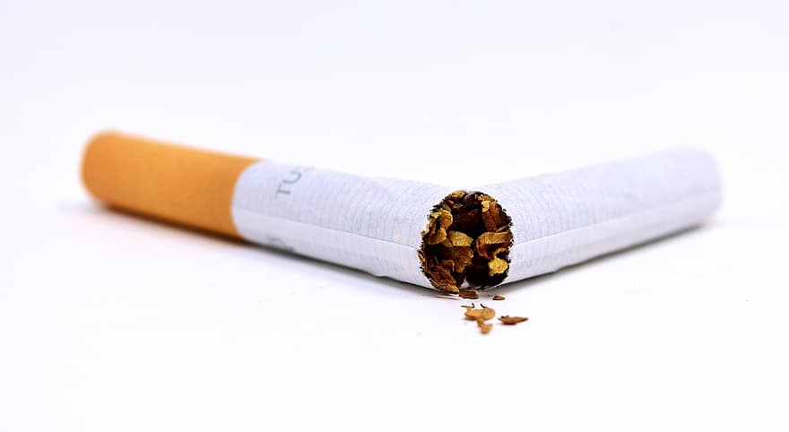
Smoking
Bradford District

Slide 2
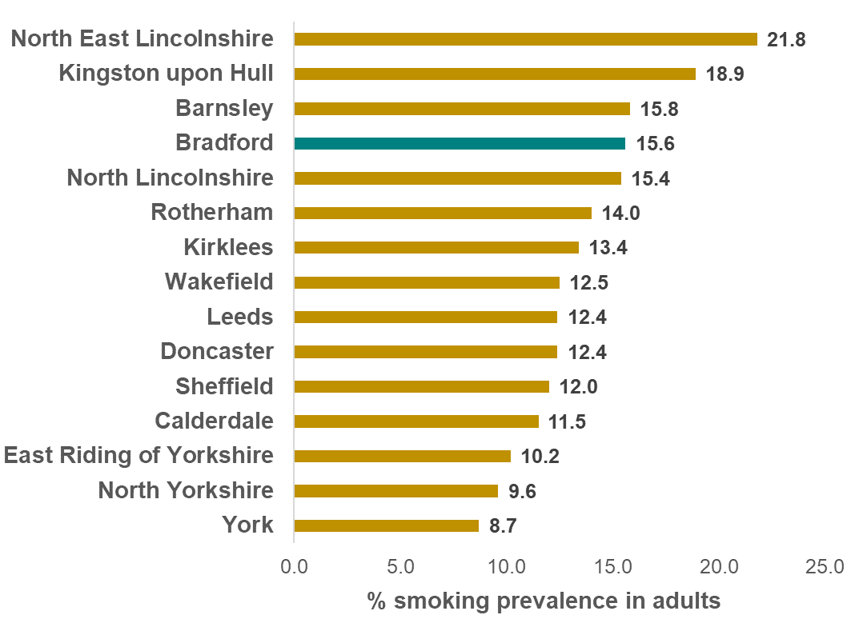
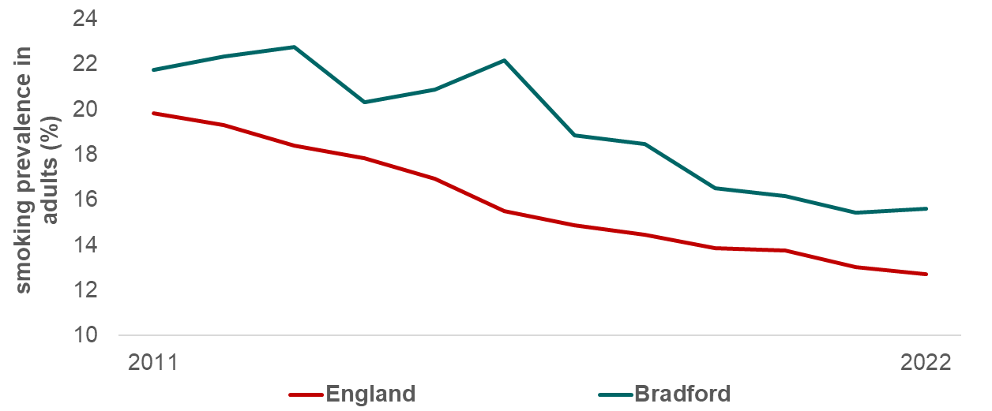
Smoking Prevalence
Prevalence of smoking among persons 18 years and over
Bradford District
National Rank
National Average
2022
Regional Average
1st
150th
15.6%
13.1%
12.7%
Lowest
126th
In 2022, 15.6% of adults within Bradford District are current smokers – higher than both the regional and national average
The gap between Bradford District and England widened over time from 1.9 to 2.9 percentage points
Bradford district had the 4th highest smoking rate in the region

Slide 3
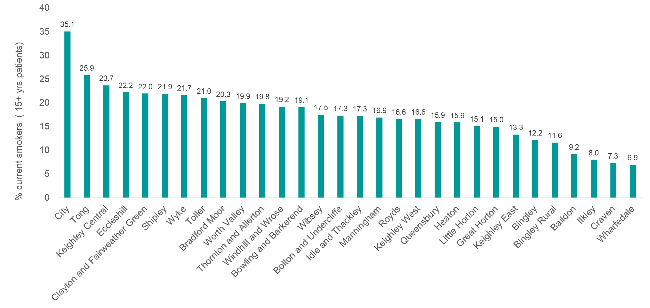
Smoking Prevalence - Wards
Smoking prevalence ranges within the Bradford District wards from 6.9% to 35.1%
Wharfedale ward has the lowest prevalence and City ward has the highest prevalence

Slide 4
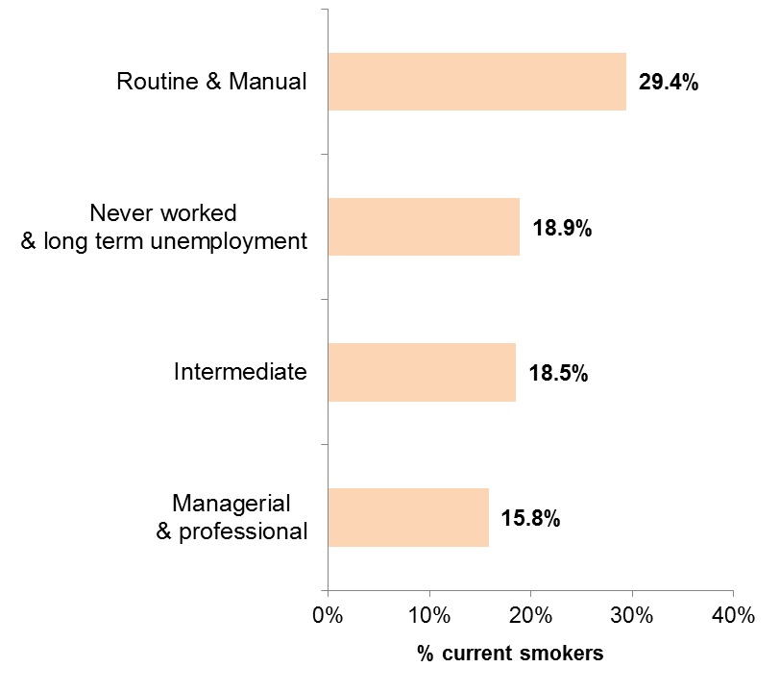
Smoking Prevalence- Gender & Socioeconomic Group
There is a higher proportion of males compared to females that smoke in Bradford District
Smoking prevalence is highest in Routine & Manual workers and lowest in Managerial & Professional workers
Smoking prevalence in adults in routine and manual occupations has reduced consistently in Bradford District since 2020. The rate is not statistically different to both regional and national average
17.7% current smokers
13.6% current smokers
(2018)

Slide 5
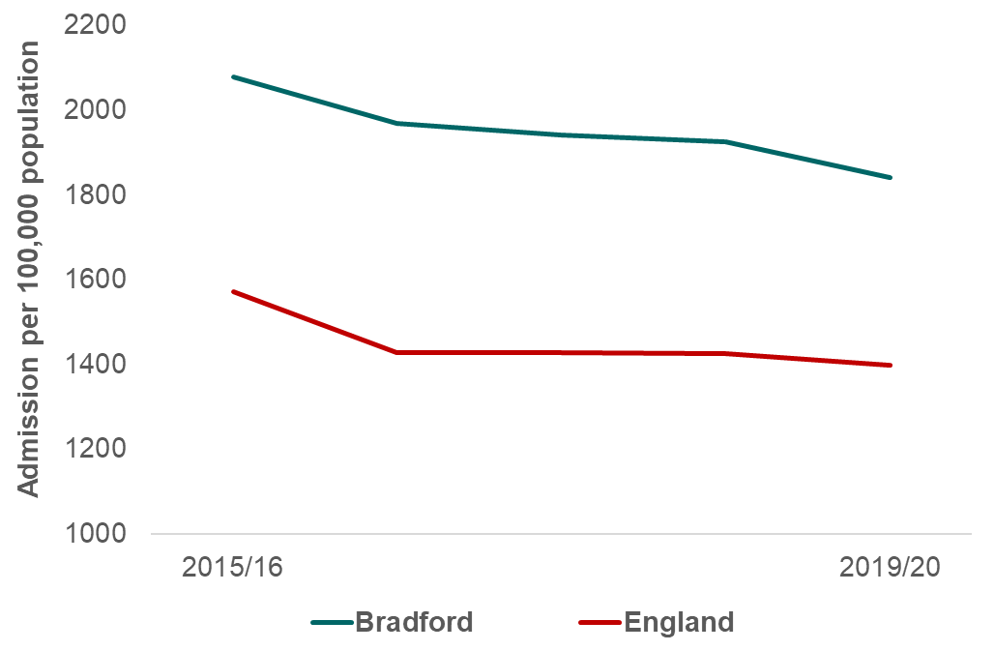
Smoking Attributable Hospital Admissions
Total number of hospital admissions for diseases that are wholly or partially attributed to smoking in persons aged 35 and over
Regional Average
National Average
National Rank
19/20
Bradford District
1st
150th
1,842
per 100,000 population
1,698
per 100,000 population
1,398
per 100,000 population
Lowest
124th
Highest
The number of hospital admissions attributable to smoking in Bradford District has decreased overall since 2015/16 and remains higher than the regional and national average
The gap between Bradford District and England has widened to 444 admissions per 100,000 population

Slide 6
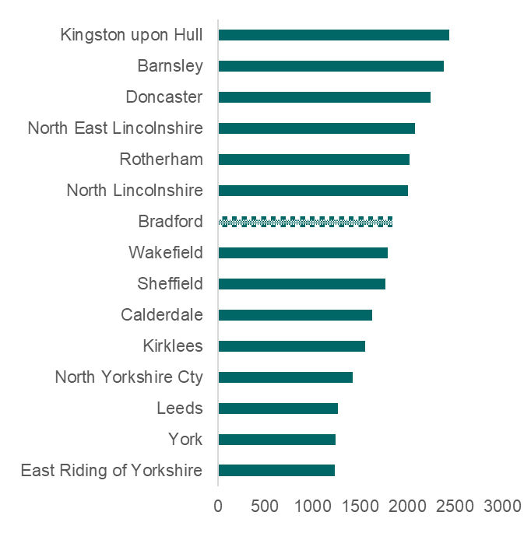
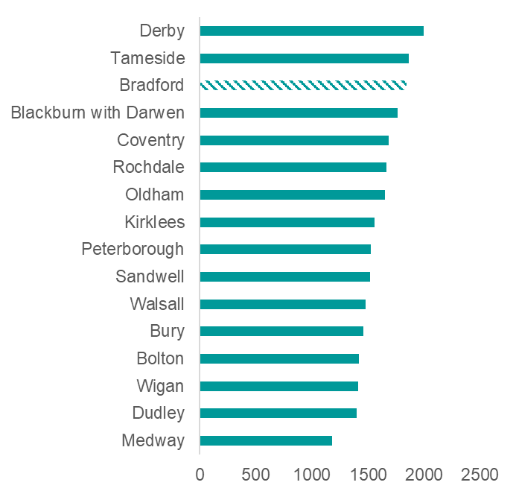
Smoking Attributable Hospital Admissions
Yorkshire & Humber and Statistical Neighbours
2019/20
=3rd highest
statistical
neighbour
= 7th highest
in the region
Admission per 100,000 population
Admission per 100,000 population
Bradford District had the 7th highest rate of hospital admissions attributable to smoking in Yorkshire and the Humber region and the 3rd Highest when compared to similar local authorities

Slide 7
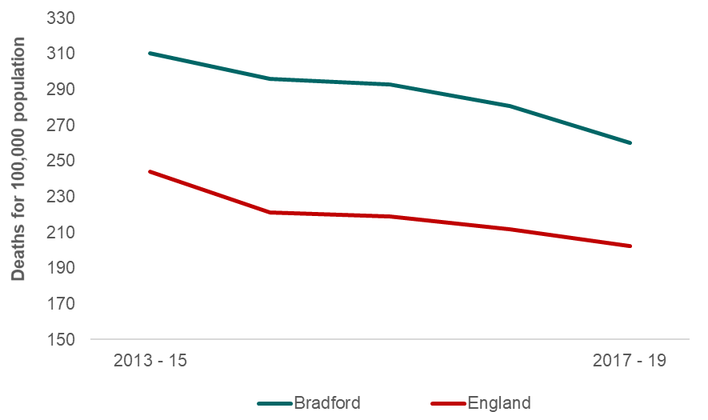
Smoking Attributable Mortality
Deaths attributable to smoking, directly age standardised rate for persons aged 35 years +
Bradford District
Regional Average
National Average
National Rank
17/19
1st
150th
260.3
per 100,000 population
239.4
per 100,000 population
202.2
per 100,000 population
Lowest
115th
Highest
The smoking attributable mortality rate in Bradford District has decreased overall since 2013-15, but remains higher than the regional and national average
The gap between Bradford District and England has widened to 58.1 deaths per 100,000 population

Slide 8
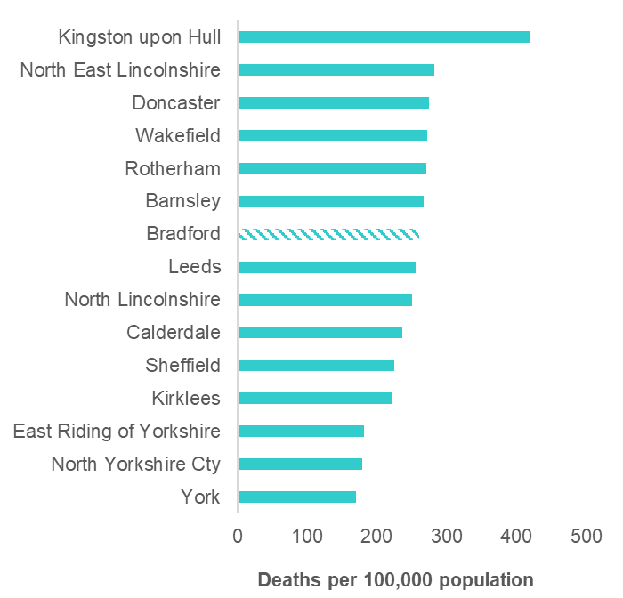
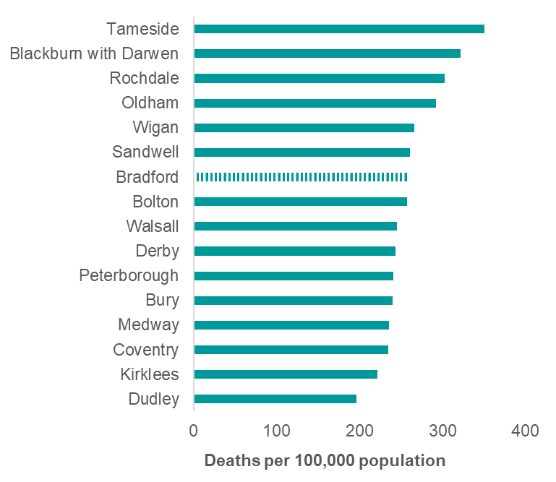
Smoking Attributable Mortality
Yorkshire & Humber & Statistical Neighbours
2017-19
Bradford District had the 7th highest rate of mortality attributable to smoking in Yorkshire and the Humber region and also had the 7th highest when compared to similar local authorities

Slide 9
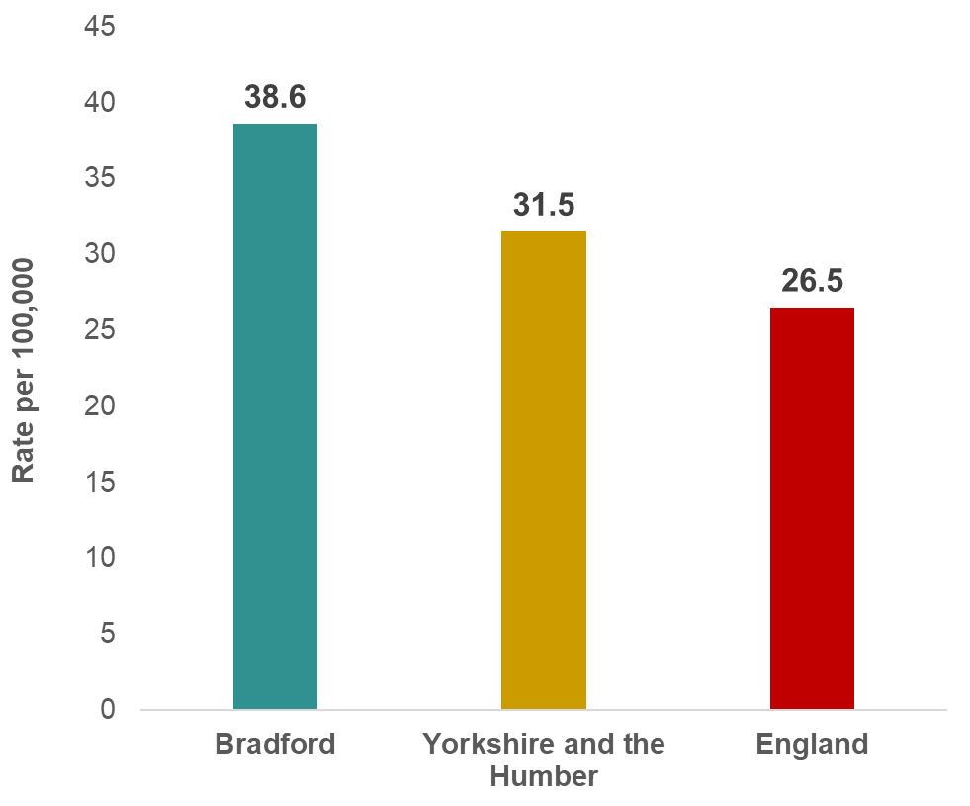
Under 75 Mortality from Respiratory Disease
Age-standardised rate of mortality from respiratory disease in persons less than 75 years per 100,000 population (2021)
National Rank
2021
1st
150th
Lowest
120th
Highest
The premature mortality rate from respiratory disease in Bradford District is above both the regional and national average
No trend data available but the gap between Bradford District and England is 12.1 deaths per 100,000 population

Slide 10
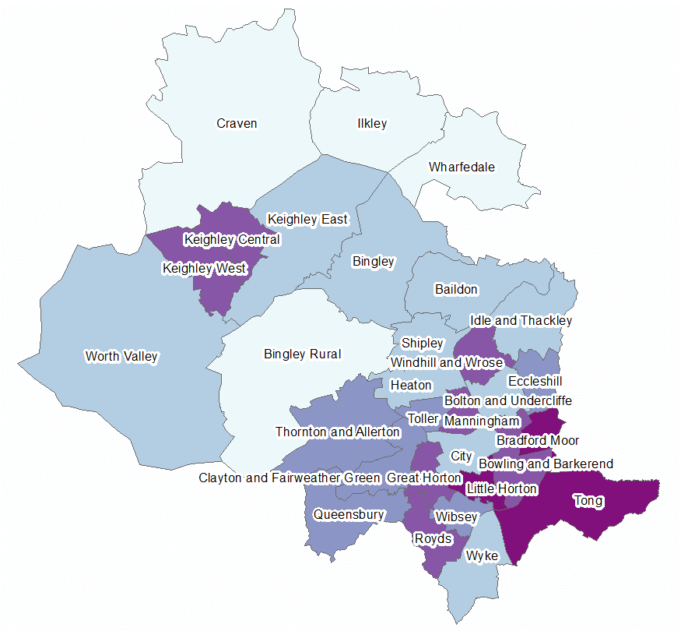
Under 75 Mortality from Respiratory Disease
Gender & Ward
DSR per 100,000 population
43.5
deaths per 100,000 population
33.8
deaths per 100,000 population
Reproduced by permission of Ordnance Survey on behalf of HMSO © Crown copyright and database right 2023
U75 mortality rate across the wards of the district ranges from 10.9 deaths per 100,000 population in Ilkley to 129.5 deaths per 100,000 population in Little Horton

Slide 11
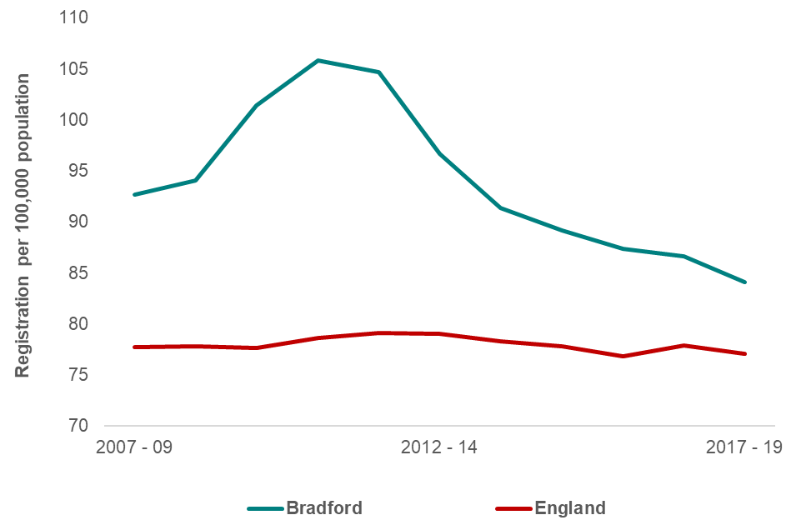
Lung Cancer Registration
Directly age-standardised registration rate for lung cancer
National Rank
Bradford District
Regional Average
National Average
17/19
1st
150th
84.1
per 100,000 population
90.9
per 100,000 population
77.1
per 100,000 population
Lowest
^{86th}
Highest
The lung cancer registration rate in Bradford District has decreased consistently since 2012-14, but remains higher than national average
The gap between Bradford District and England has narrowed to 7.0 deaths per 100,000 population

Slide 12
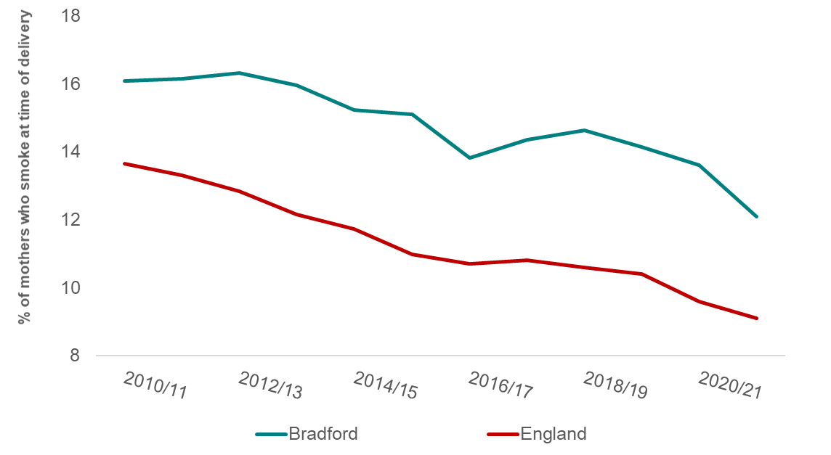
Smoking at Time of Delivery
The number of mothers known to be smokers at the time of delivery as a percentage of all maternities
Bradford District
Regional Average
National Average
National Rank
21/22
1st
150th
12.1%
12.0%
9.1%
Lowest
124th
Highest
The proportion of mothers smoking at the time of delivery within Bradford District has decreased overall since 2010/11
Despite this decrease the gap between Bradford District and England has narrowed to 3.0 percentage points
Notes:
60337560

Slide 13
Statistics on NHS Stop Smoking Services
Percentage of persons who successfully quit smoking(self-reported) after setting a quit date
In 2022/23, 50% of persons who set quit date in Bradford District successful quit smoking by the set date.
Bradford’s rate is lower than both regional (63%) and national (54%) rate

Slide 14
Impacts of Smoking
£
In 2016/17
£9,182,362
was spent on
Smoking Attributable
Hospital Admissions
in Bradford District
1,860 years of life are lost
per 100,000 population
each year
in Bradford District due to
Smoking Related Illness
The cost per capita decreased over time
but remains above the national average
This is the 19th highest rate of 150 local authorities in England

Slide 15
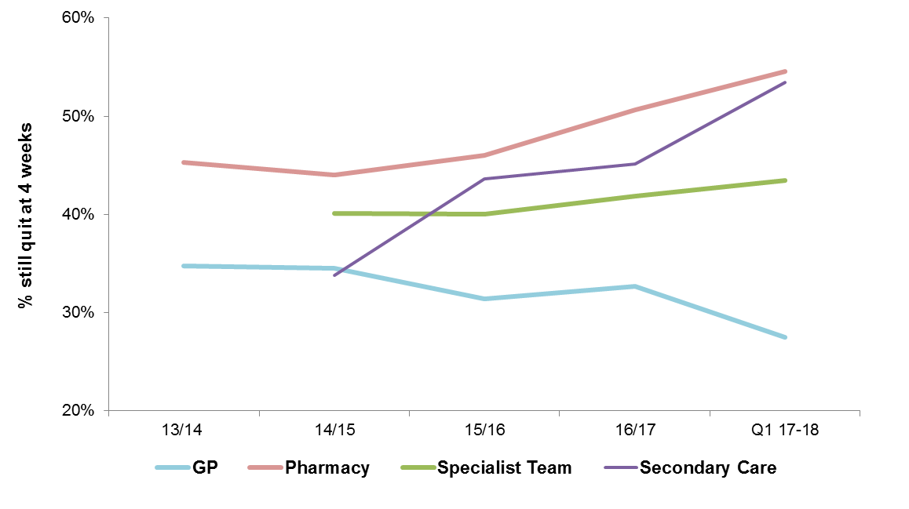
Smoking Cessation – Services
Percentages of persons still quit at 4 weeks using different stop smoking services across Bradford District
Pharmacy stop smoking services consistently have the highest % of people still quit at 4 weeks
Pharmacy, Secondary Care and Specialist Team services have all seen increases in % of persons still quit at 4 weeks, but GP still quit at 4 weeks percentages have fallen over time

Slide 16
Indicator | Definition | Source
Smoking prevalence | Prevalence of smoking among persons 18 years and over | Annual Population Survey (APS)
Smoking attributable hospital admissions | Total number of hospital admissions for diseases that are wholly or partially attributed to smoking in persons aged 35 and over | NHS Digital - Hospital Episode Statistics (HES)
Smoking attributable mortality | Deaths attributable to smoking, directly age standardised rate for persons aged 35 years + | ONS mortality files
Potential years of life lost due to smoking related illness | Directly age-standardised rate of potential years of life lost in adults aged 35-74 due to smoking related causes | ONS
Cost per capita of smoking attributable hospital admissions | Cost per capita of hospital admissions for diseases that are wholly or partially attributed to smoking in persons aged 35 and over | PHE
Lung cancer registrations | Directly age-standardised registration rate for lung cancer, in persons of all ages, per 100,000 2013 European Standard Population | PHE - National Cancer Registration and Analysis Service
U75 mortality from respiratory disease | Age-standardised rate of mortality from respiratory disease in persons less than 75 years per 100,000 population | PHE based on ONS source data
Smoking at time of delivery | The number of mothers known to be smokers at the time of delivery as a percentage of all maternities. | Calculated by PHE from the NHS Digital return on Smoking Status At Time of delivery
Smoking at time of delivery (Ward data) | The number of mothers known to be smokers at the time of delivery as a percentage of all maternities. | Bradford District Stop Smoking Service
NHS Stop Smoking Services | Percentage of persons who successfully quit smoking(self-reported) after setting a quit date | NHS Digital
Smoking Cessation - Services | Percentages of persons still quit at 4 weeks using different stop smoking services across Bradford District | Bradford District Stop Smoking Service

